Slide 1

Modeling complex behavior in social media
Meng Jiang (Office 2130, Siebel Center)
Department of Computer Science
University of Illinois at Urbana-Champaign
www.meng-jiang.com
Notes:
Talk about my work; everybody knows the social media.
Does anyone never use the social media, Facebook or Twitter.
Even my grandpa uses Weibo,
Posting photos about himself, at 45 degree
And his food, like a young lady.
1. Twitter is blocked (not accessible unless vpn),
2. he cannot count the 26 english letters.
Every day, we generate behaviors in social media. What is modeling, why and how.

Slide 2
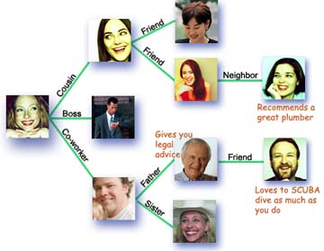
User Behavior in Social Media
Users
Relations
User-user interaction behaviors
User-information interaction behaviors
Information
User behavior is a fundamental element in social media
Notes:
Two basic types of behaviors.
One is communicating with people, our family, friends, classmates, advisors.
The other is understanding or enjoying the environment, the news, books, lessons.

Slide 3
Behavioral Modeling
Understanding
Predicting
Intervening
Notes:
Your girlfriend is sad and locks herself in her bedroom.
Understand her behavior, why she is not happy.
Predict or guess what happened if you know she meets her advisor today and now comes back and she is unhappy.
Intervene her. Make her happy. Though you dare not talk with her advisor, you can buy some flowers.
It is also good for you to be able to predict whether she will be unhappy if you do something bad.
Then you can intervene yourself. Stop doing that thing.
I think these three parts, or behavioral modeling, is one of the most frequent things I did every day.

Slide 4
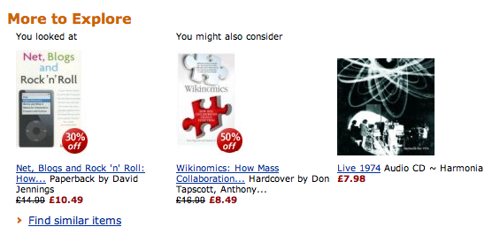
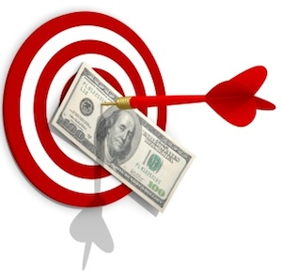



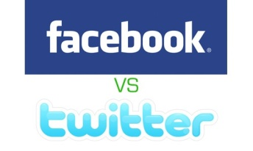

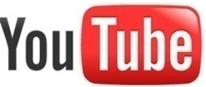

Applications of Behavioral Modeling
Recommendation
Targeting AD
Anti Spam
Notes:
For social media, there are many applications based on behavioral modeling.
I list three of them here.

Slide 5
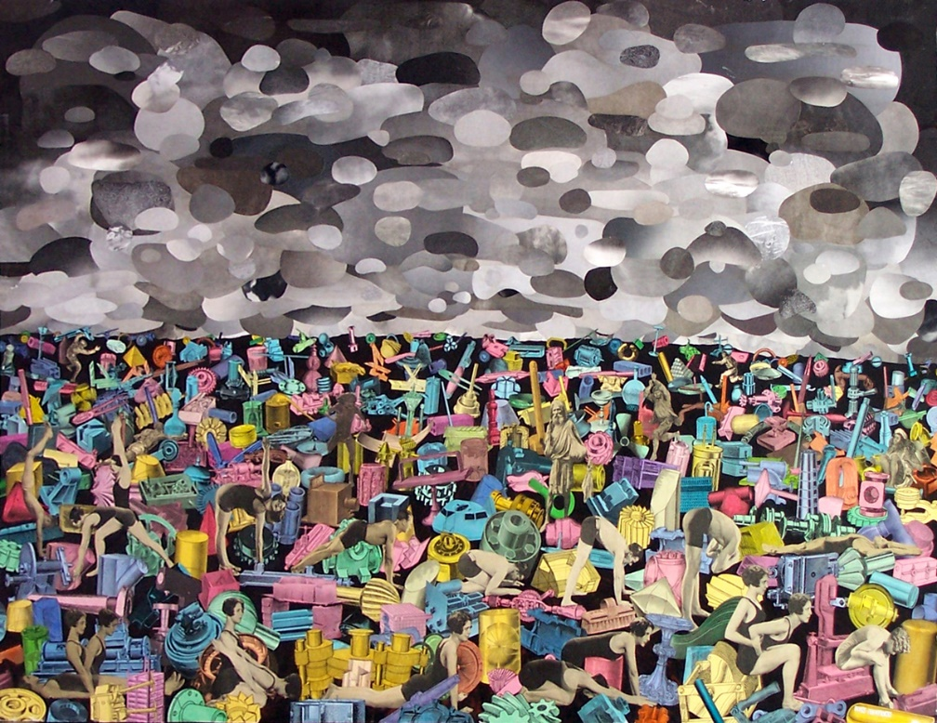
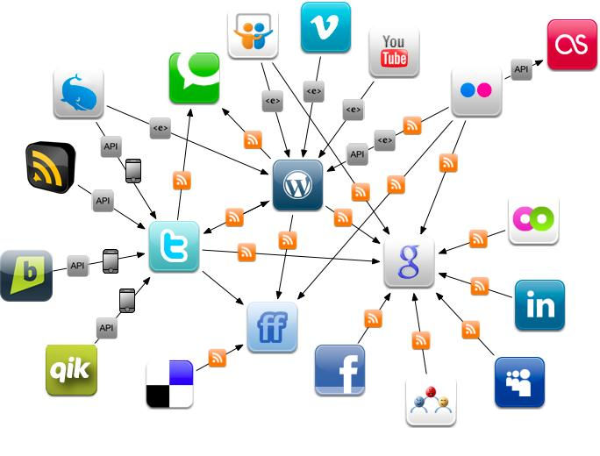
Scientific Value of Behavioral Modeling
Physical World
Online Social Networks
The human behaviors are broadly and deeply
recorded in an unprecedented level.
This is the first time that we can get insights of human behaviors and the society from large scale real data.
Notes:
In the physical world, it is hard to collect signals, information, behaviors.
Think what we can have if our ancestors are able to record their voice, or their behaviors into videos.
We can learn a lot and a lot. But it does not happen.
Now the social media can do it. Our behaviors are all on the webpages and in the databases.
This is the first time that we can get insights of human behaviors and the society from large scale real data.

Slide 6
User Behaviors are Complex
Content
User Behavior
Context
Social
Intention
Notes:
However, modeling the behaviors is not easy.
User behaviors are complex.
They are related to content, social, context and intention.
I will explain the four factors one by one.

Slide 7
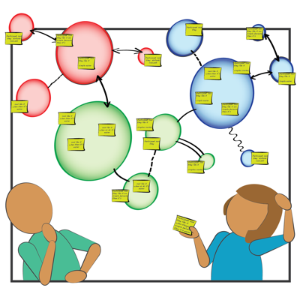
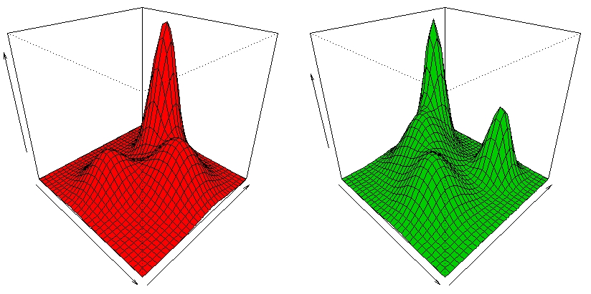
Content Related
User preference is an important driving factor for user behavior modeling.
Notes:
Preference and content. I like basketball. So I share the sport news.

Slide 8
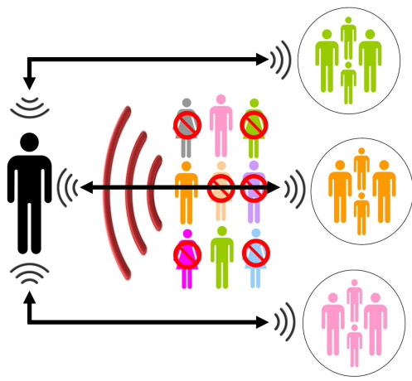
Social Related
User behavior in social networks are highly dependent on social peers.
Notes:
Social relation, trust, influence. Our decisions depend on not only ourselves but also our friends.

Slide 9
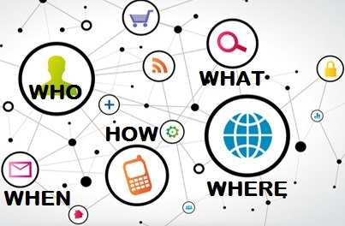
Context Related
Rich context info in social networks. How to couple them with behavioral modeling?
Notes:
Our decisions depend on not only who we are, what we choose, but also where we are, when it is, how we can get the information.

Slide 10
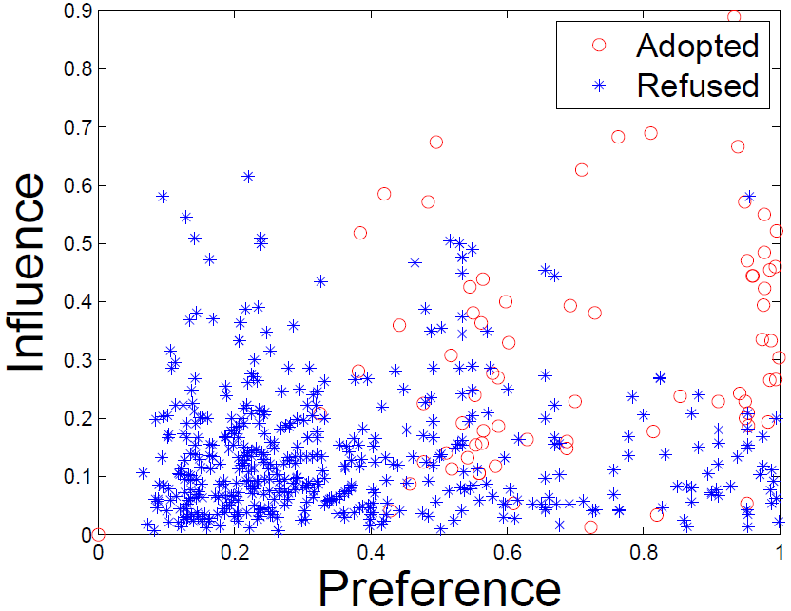
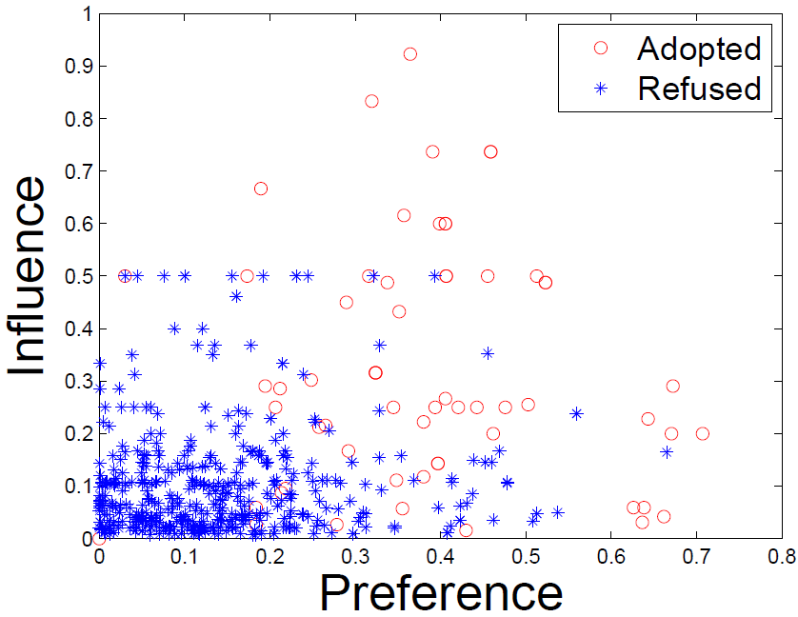
Social Contextual Factors
Individual Preference & Interpersonal Influence
China’s Facebook:
Renren
China’s Twitter:
Tencent Weibo
Jiang et al. Social Contextual Recommendation. CIKM, 2012. Social Recommendation with Contextual Information. TKDE, 2014.
Notes:
Understand and predict the behaviors. Sharing articles. Retweeting.

Slide 11
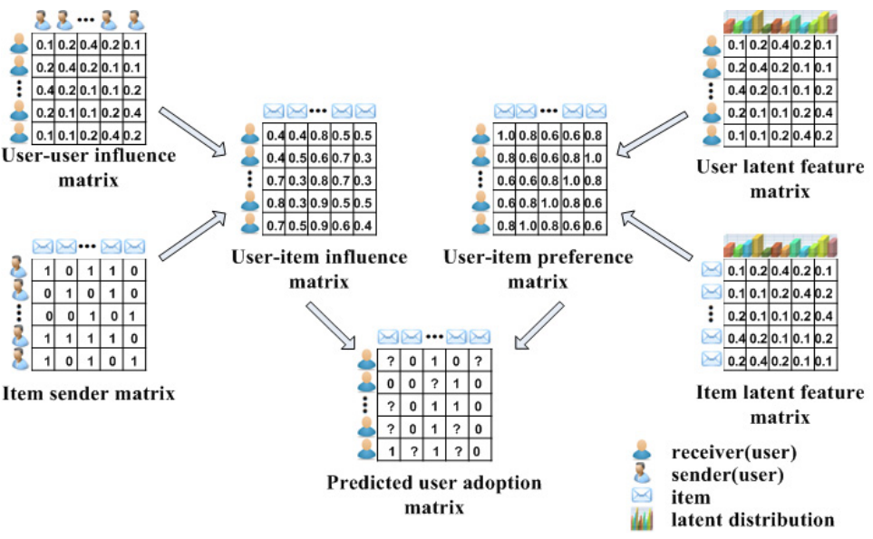
Social Contextual Recommendation
ContextMF
S
U
G
V
R
Jiang et al. Social Contextual Recommendation. CIKM, 2012. Social Recommendation with Contextual Information. TKDE, 2014.
Notes:
Transferred to Weibo’s recommender system.

Slide 12
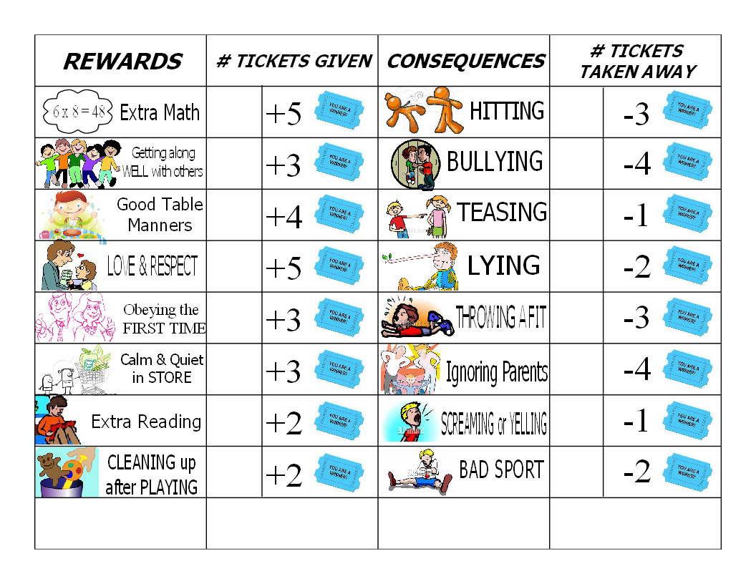
Intention Related
A nontrivial part of user behaviors are from profitable and social purposes.
Intention can account for the behaviors that cannot be well interpreted by content, social and context.
Notes:
Some people want news about their friends, about the world.
Some want to add every beautiful girl on the web as their friend and ask her out.
Some want to promote their products with some shorten links.
Some want to be popular, to raise their marketing value.
Different intentions have different patterns.

Slide 13
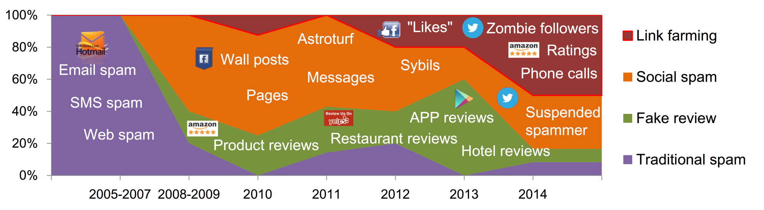
Suspicious Behavior Detection
Social Link Farming
Suspicious Behavior Detection: Current Trends and Future Directions.
Special Issue on Online Behavioral Analysis and Modeling, IEEE Intelligent Systems Magazine (ISSI), 2016.
Notes:
Collect over 100 papers in top conferences and journals.

Slide 14

Social Link Farming
Selling Twitter followers
Notes:
If we use a link to represent the connection between a follower and a followee,
there are too many fake links in the network.
The followee’s indegree is being inflated to a huge number.

Slide 15
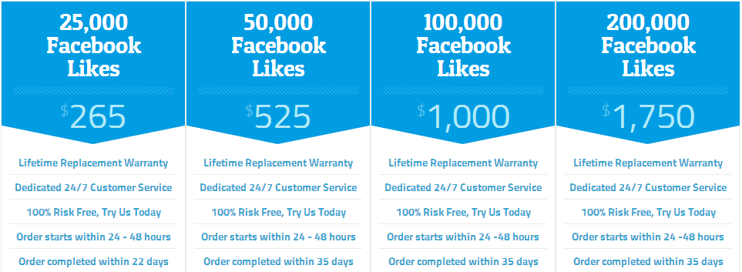
Social Link Farming
Selling Facebook Likes
Notes:
If we use a link to represent the connection between a user and a page,
we can also observe many fake link.
The page’s indegree is surprisingly large.

Slide 16
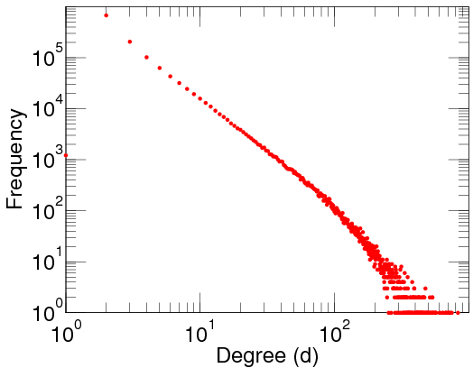
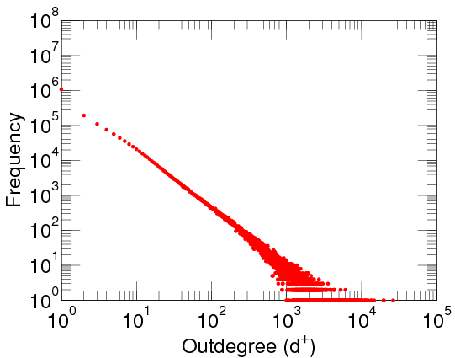
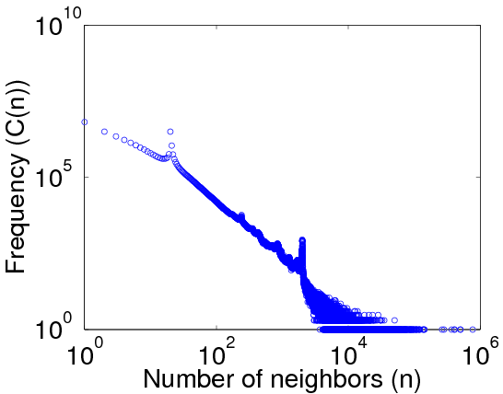
Power-Law Distribution
Out-degree distribution
DBLP Author-publication | Flickr User-user | Twitter Who-follows-whom
[konect.uni-koblenz.de/networks/]
Jiang et al. CatchSync: Catching Synchronized Behavior in Large Directed Graphs. KDD Best Paper Finalist, 2014.

Slide 17


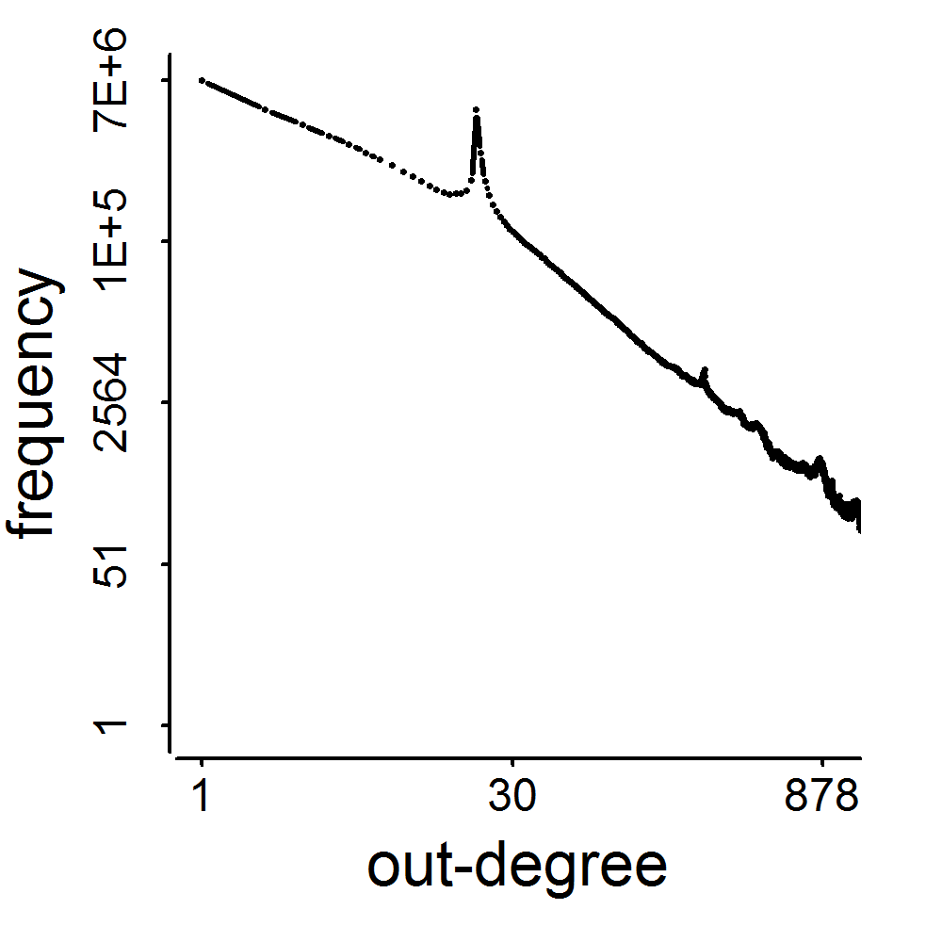
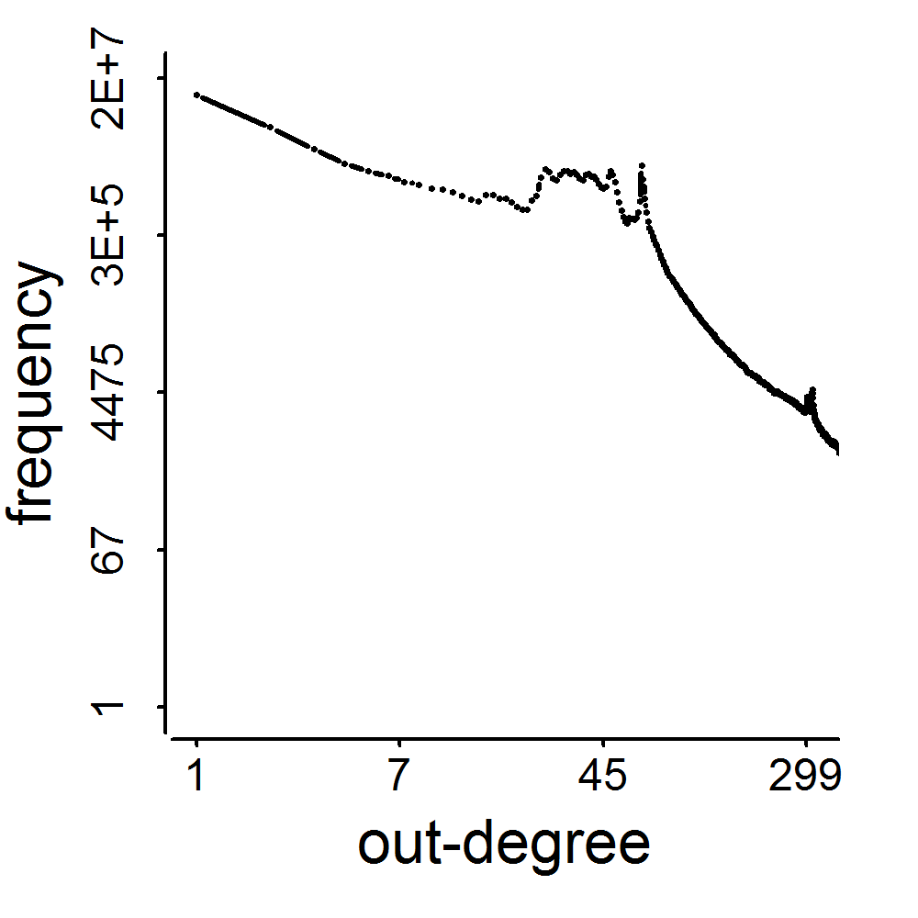
2009
41M
2011
117M
3.17M
1.91M
0.41M
0.44M
d=20
d=64
Jiang et al. CatchSync: Catching Synchronized Behavior in Large Directed Graphs. KDD Best Paper Finalist, 2014.
Notes:
Consistently connect to …
In lockstep.

Slide 18
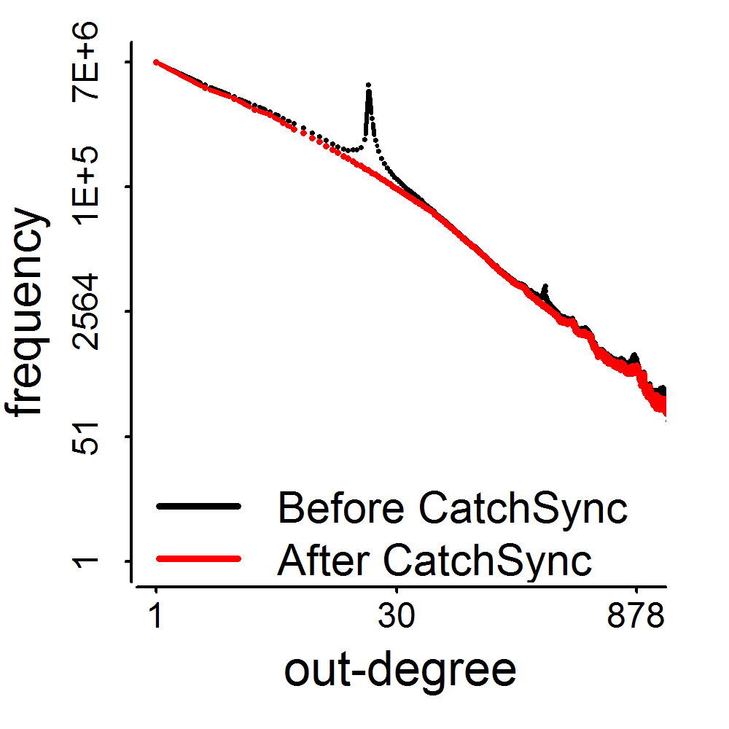
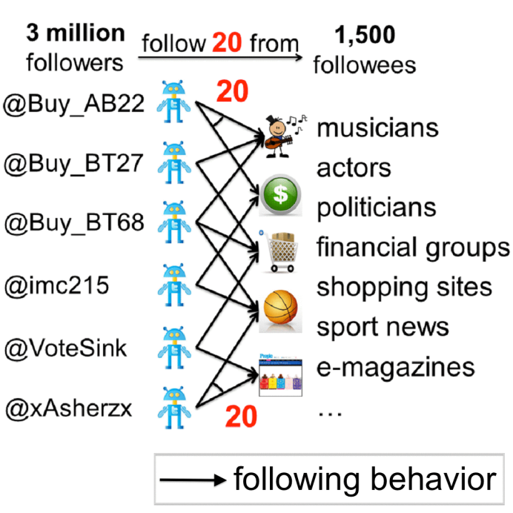
Catch from Twitter
2009
3.17M
41M
0.41M
d=20
Jiang et al. CatchSync: Catching Synchronized Behavior in Large Directed Graphs. KDD Best Paper Finalist, 2014.
Notes:
Catch the lockstep behaviors.

Slide 19
Behavioral Modeling
Content
Understand single factors
Understand their couplings
Unify them for behavior modeling and prediction
User Behavior
Context
Social
Intention

Slide 20
Roadmap
Social
(CIKM12, TKDE14)
Context
Social Recommendation
Spatial
Temporal
(KDD14)
Cross-Domain
Cross-Platform
(CIKM12, TKDE15, AAAI16)
Suspicious Behavior Detection
(WWW14, PAKDD14, KAIS15, Survey-ISSI16, TKDD16)
Observation & Algorithm
(KDD14 Best Paper Finalist)
Metric for Suspiciousness
(ICDM15)

Slide 21
Acknowledge
Prof. Jiawei Han
Computer Science
UIUC

Slide 22
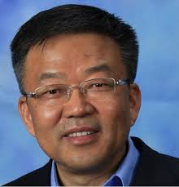


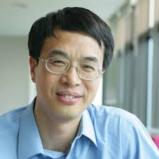
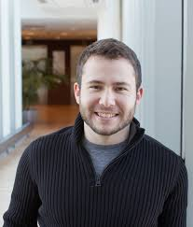
Acknowledge
Prof. Shiqiang Yang
Tsinghua U
Prof. Fei Wang
University of Connecticut
Prof. Christos Faloutsos
CMU
Prof. Wenwu Zhu
Tsinghua U
Prof. Peng Cui
Tsinghua U
Alex Beutel
CMU

Slide 23
Thank you!
Modeling Complex Behavior in Social Media
www.meng-jiang.com

